Slide 2
Explore and analyze data with R
Speaker Name
Title
Speaker Name
Title
Notes:
Link to published module on Learn: Explore and analyze data with R - Learn | Microsoft Docs

Slide 3
Learning objectives
Common data exploration and analysis tasks
How to use R packages like ggplot2 and dplyr to turn raw data into understanding, insight and knowledge
Examine real world data

Slide 4
Introduction

Slide 5

Introduction
Unsurprisingly, the role of a data scientist primarily involves exploring and analyzing data.
Tidyverse is a collection of R packages that make data science faster, easier and more fun.
Tidymodels is a collection of R packages for modeling and statistical analysis.
TensorFlow for R and Torch for R supply machine learning and deep learning capabilities.
Notes:
Unsurprisingly, the role of a data scientist primarily involves exploring and analyzing data. The results of an analysis might form the basis of a report or a machine learning model, but it all begins with data, with R being one of the most popular programming languages for data scientists. R can be used for many purposes and prides itself in being an elegant and beautiful environment designed to support data science.
After decades of open-source development, R provides extensive functionality with a massive set of powerful statistical modeling, machine learning, visualization and data wrangling packages. For instance:
Tidyverse is a collection of R packages that make data science faster, easier and more fun.
Tidymodels is a collection of R packages for modeling and statistical analysis.
TensorFlow for R and Torch for R supply machine learning and deep learning capabilities.
Usually, a data analysis project is designed to establish insights around a particular scenario or to test a hypothesis.
For example, suppose a university professor collects data from their students, including the number of lectures attended, the hours spent studying, and the final grade achieved on the end of term exam. The professor could analyze the data to determine if there's a relationship between the amount of studying a student undertakes and the final grade they achieve. The professor might use the data to test a hypothesis that only students who study for a minimum number of hours can expect to achieve a passing grade.

Slide 6
Exploratory data analysis

Slide 7
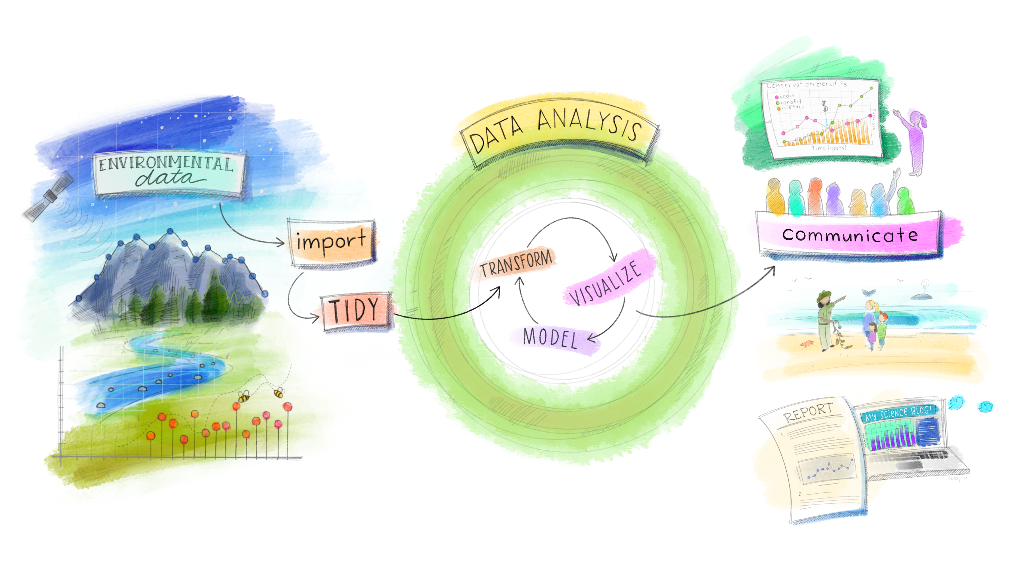
Exploratory data analysis
Exploratory Data Analysis (EDA) is an iterative cycle of analyzing data sets to summarize their main characteristics, often by visualizing and transforming your data.
Images: allisonhorst
Notes:
Exploratory Data Analysis, popularly referred to as EDA, is an iterative cycle of analyzing data sets to summarize their main characteristics, often by visualizing and transforming your data.
Data scientists can use various tools and techniques to explore, visualize, and manipulate data. One of the most common ways in which data scientists work with data is to use the R language and some specific packages for data exploratory. One of these packages is the Tidyverse – a collection of packages that provide tooling for the most common data science challenges[1]. Some of the packages in the Tidyverse that you'll interact with include ggplot2, dplyr and tibble.

Slide 8
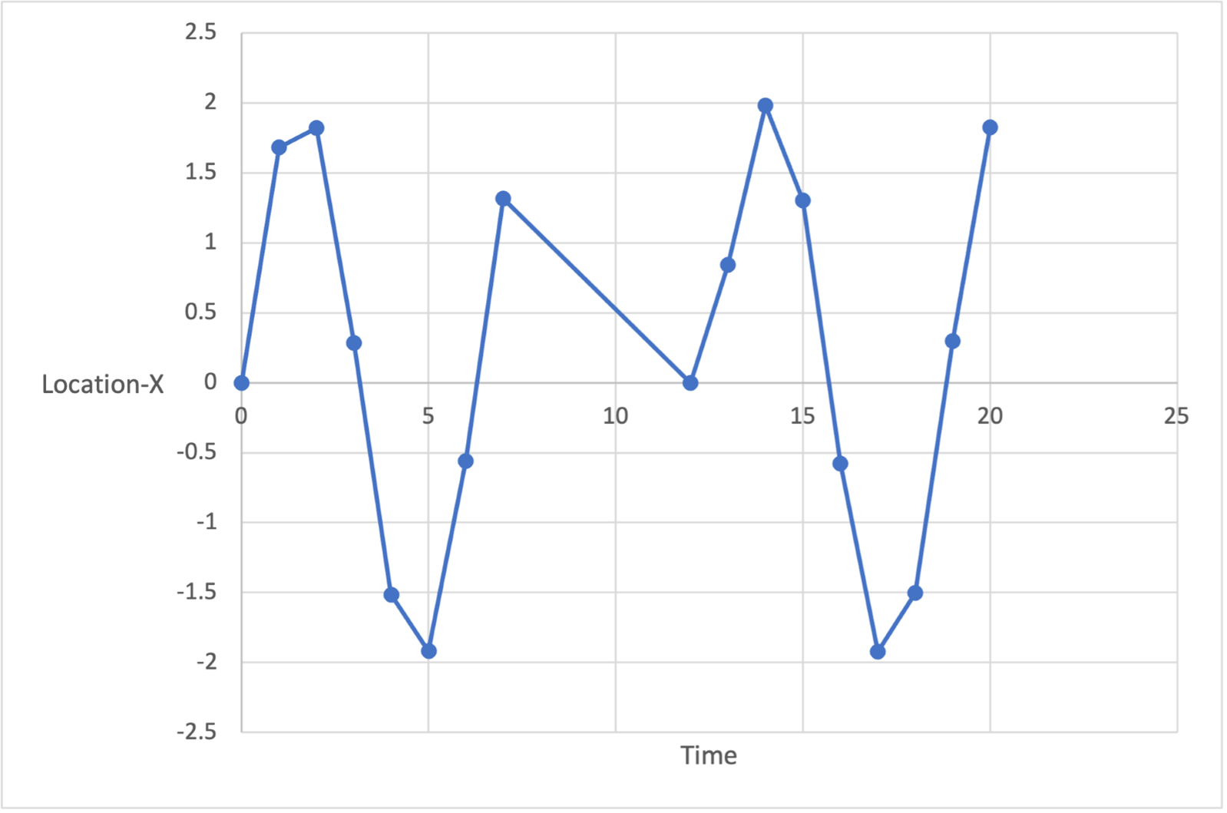
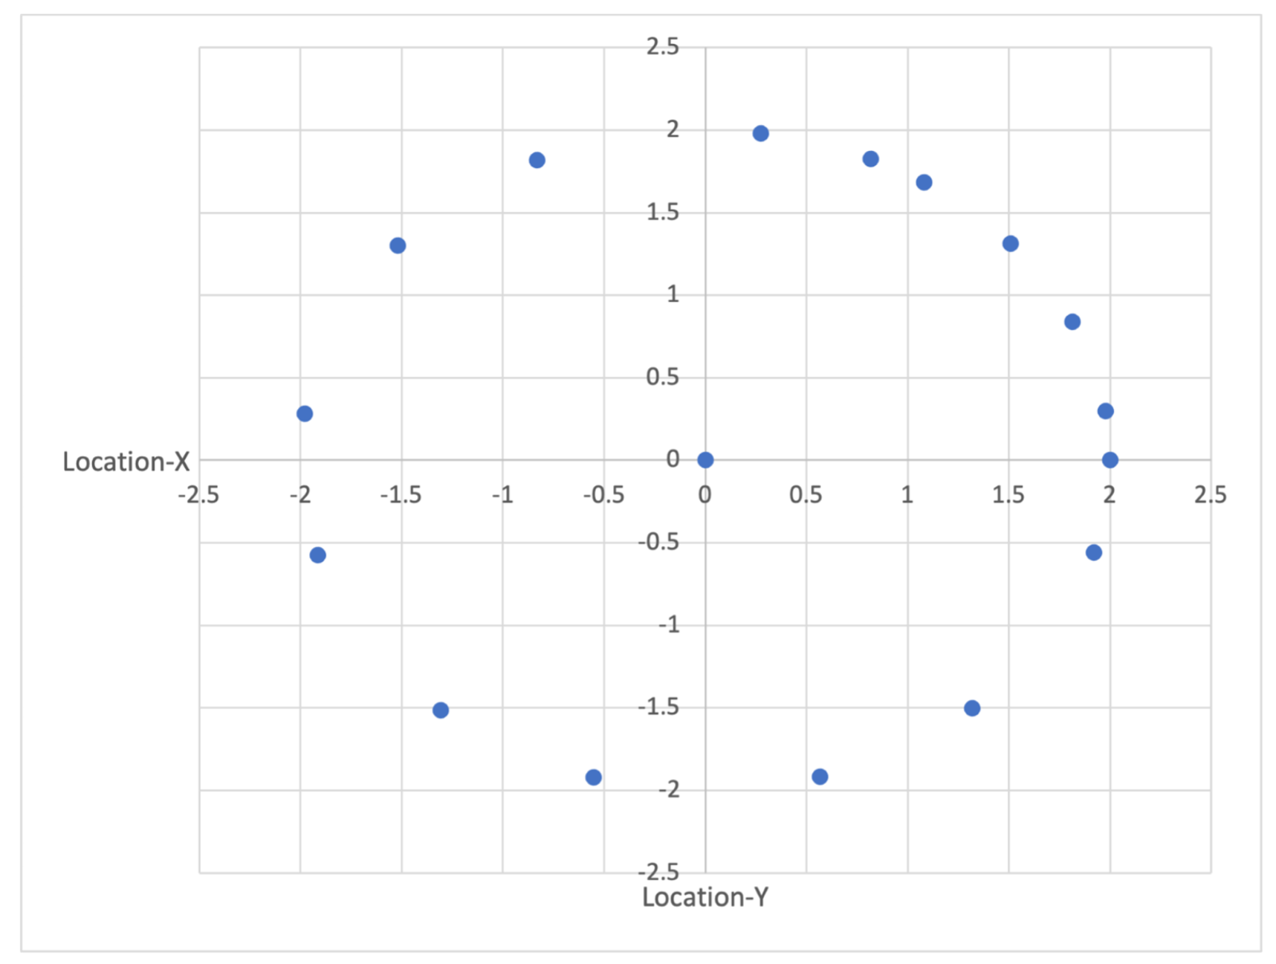
Visualize data
Representing data visually typically means graphing it.
Time | Location-X | Location-Y
0 | 0 | 2
1 | 1.682942 | 1.080605
2 | 1.818595 | -0.83229
3 | 0.28224 | -1.97998
4 | -1.5136 | -1.30729
5 | -1.91785 | 0.567324
6 | -0.55883 | 1.920341
7 | 1.313973 | 1.507805
12 | 0.00001 | 0.00001
13 | 0.840334 | 1.814894
14 | 1.981215 | 0.273474
15 | 1.300576 | -1.51938
16 | -0.57581 | -1.91532
17 | -1.92279 | -0.55033
18 | -1.50197 | 1.320633
19 | 0.299754 | 1.977409
20 | 1.825891 | 0.816164
Notes:
Representing data visually typically means graphing it. This is done to provide a fast qualitative assessment of our data, which can be useful for understanding results, finding outlier values, understanding how numbers are distributed, raising new questions about the data and so on.
While sometimes we know ahead of time what kind of graph will be most useful, other times we use graphs in an exploratory way. To understand the power of data visualization, consider the data below: the location (x,y) of a self-driving car. In its raw form, it's hard to see any real patterns. The mean or average tells us that its path was centered around x=0.2 and y=0.3, and the range of numbers appears to be between about -2 and 2.
[Table was here]
If we now plot Location-X over time, we can see that we appear to have some missing values between times 7 and 12.
If we graph X vs Y, we end up with a map of where the car has driven. It's instantly obvious that the car has been driving in a circle, but at some point, drove to the center of that circle.
Graphs aren't limited to 2D scatter plots like those above but can be used to explore other kinds of data, like proportions - shown through pie charts, stacked bar graphs - how data are spread - with histograms, box and whisker plots - and how two data sets differ. Often, when we're trying to understand raw data or results, we may experiment with different types of graphs until we come across one that explains the data in a visually intuitive way.

Slide 9
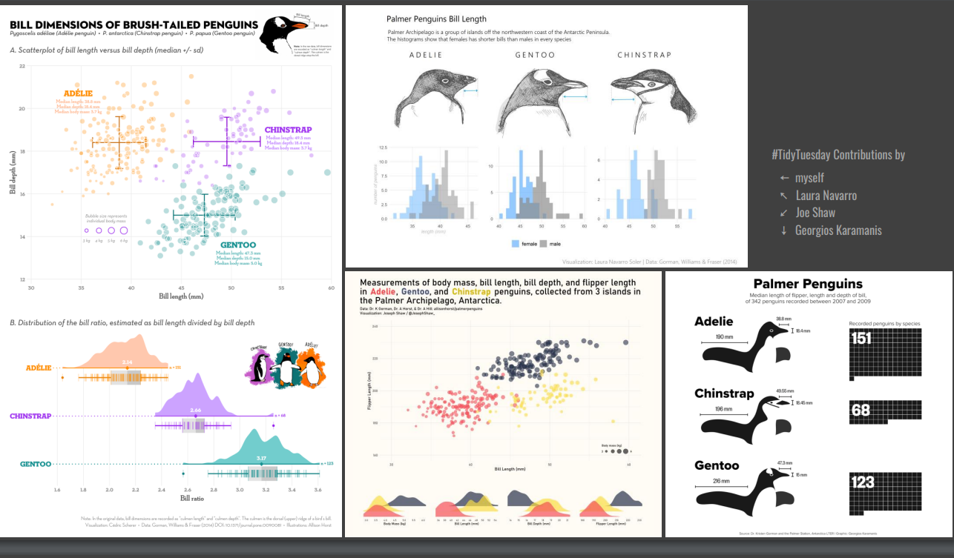
Data visualization using ggplot2
Ggplot2 is an R package for creating elegant graphics for data analysis.
Notes:
ggplot2 is an R package for creating elegant graphics for data analysis. ggplot2 provides a flexible way of creating graphs by combining independent components of a graphic in a series of iterative steps. This makes ggplot2 one of the most versatile and powerful tools for making graphs in R.

Slide 10
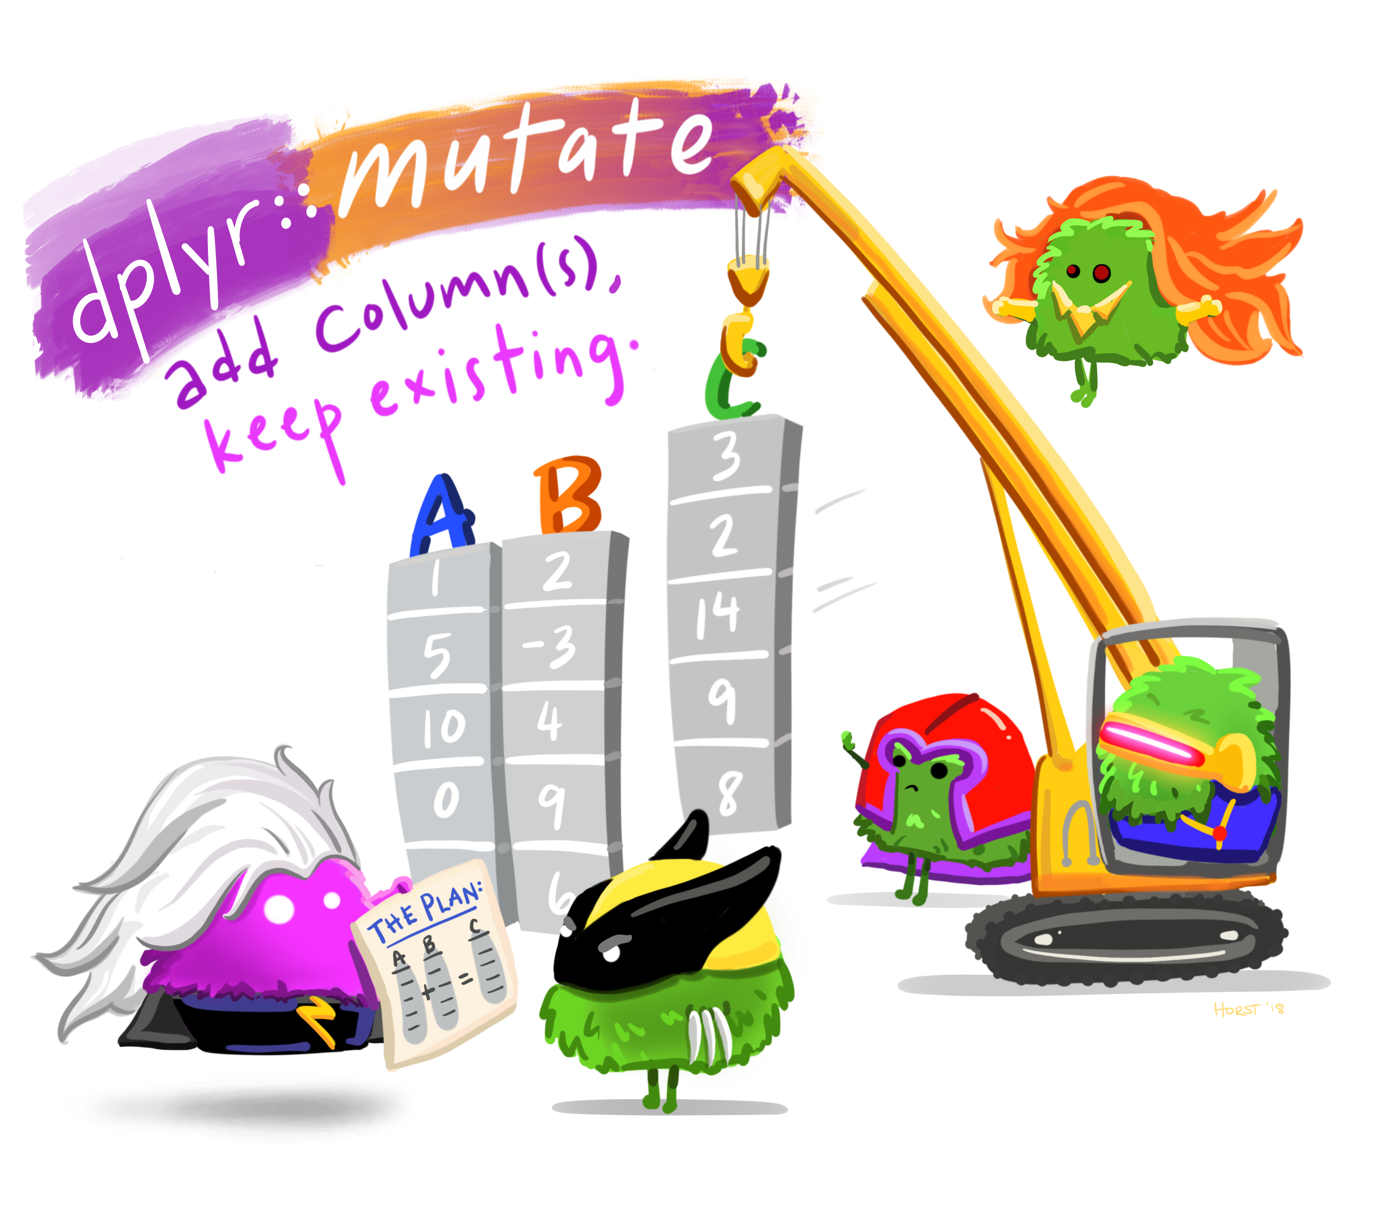
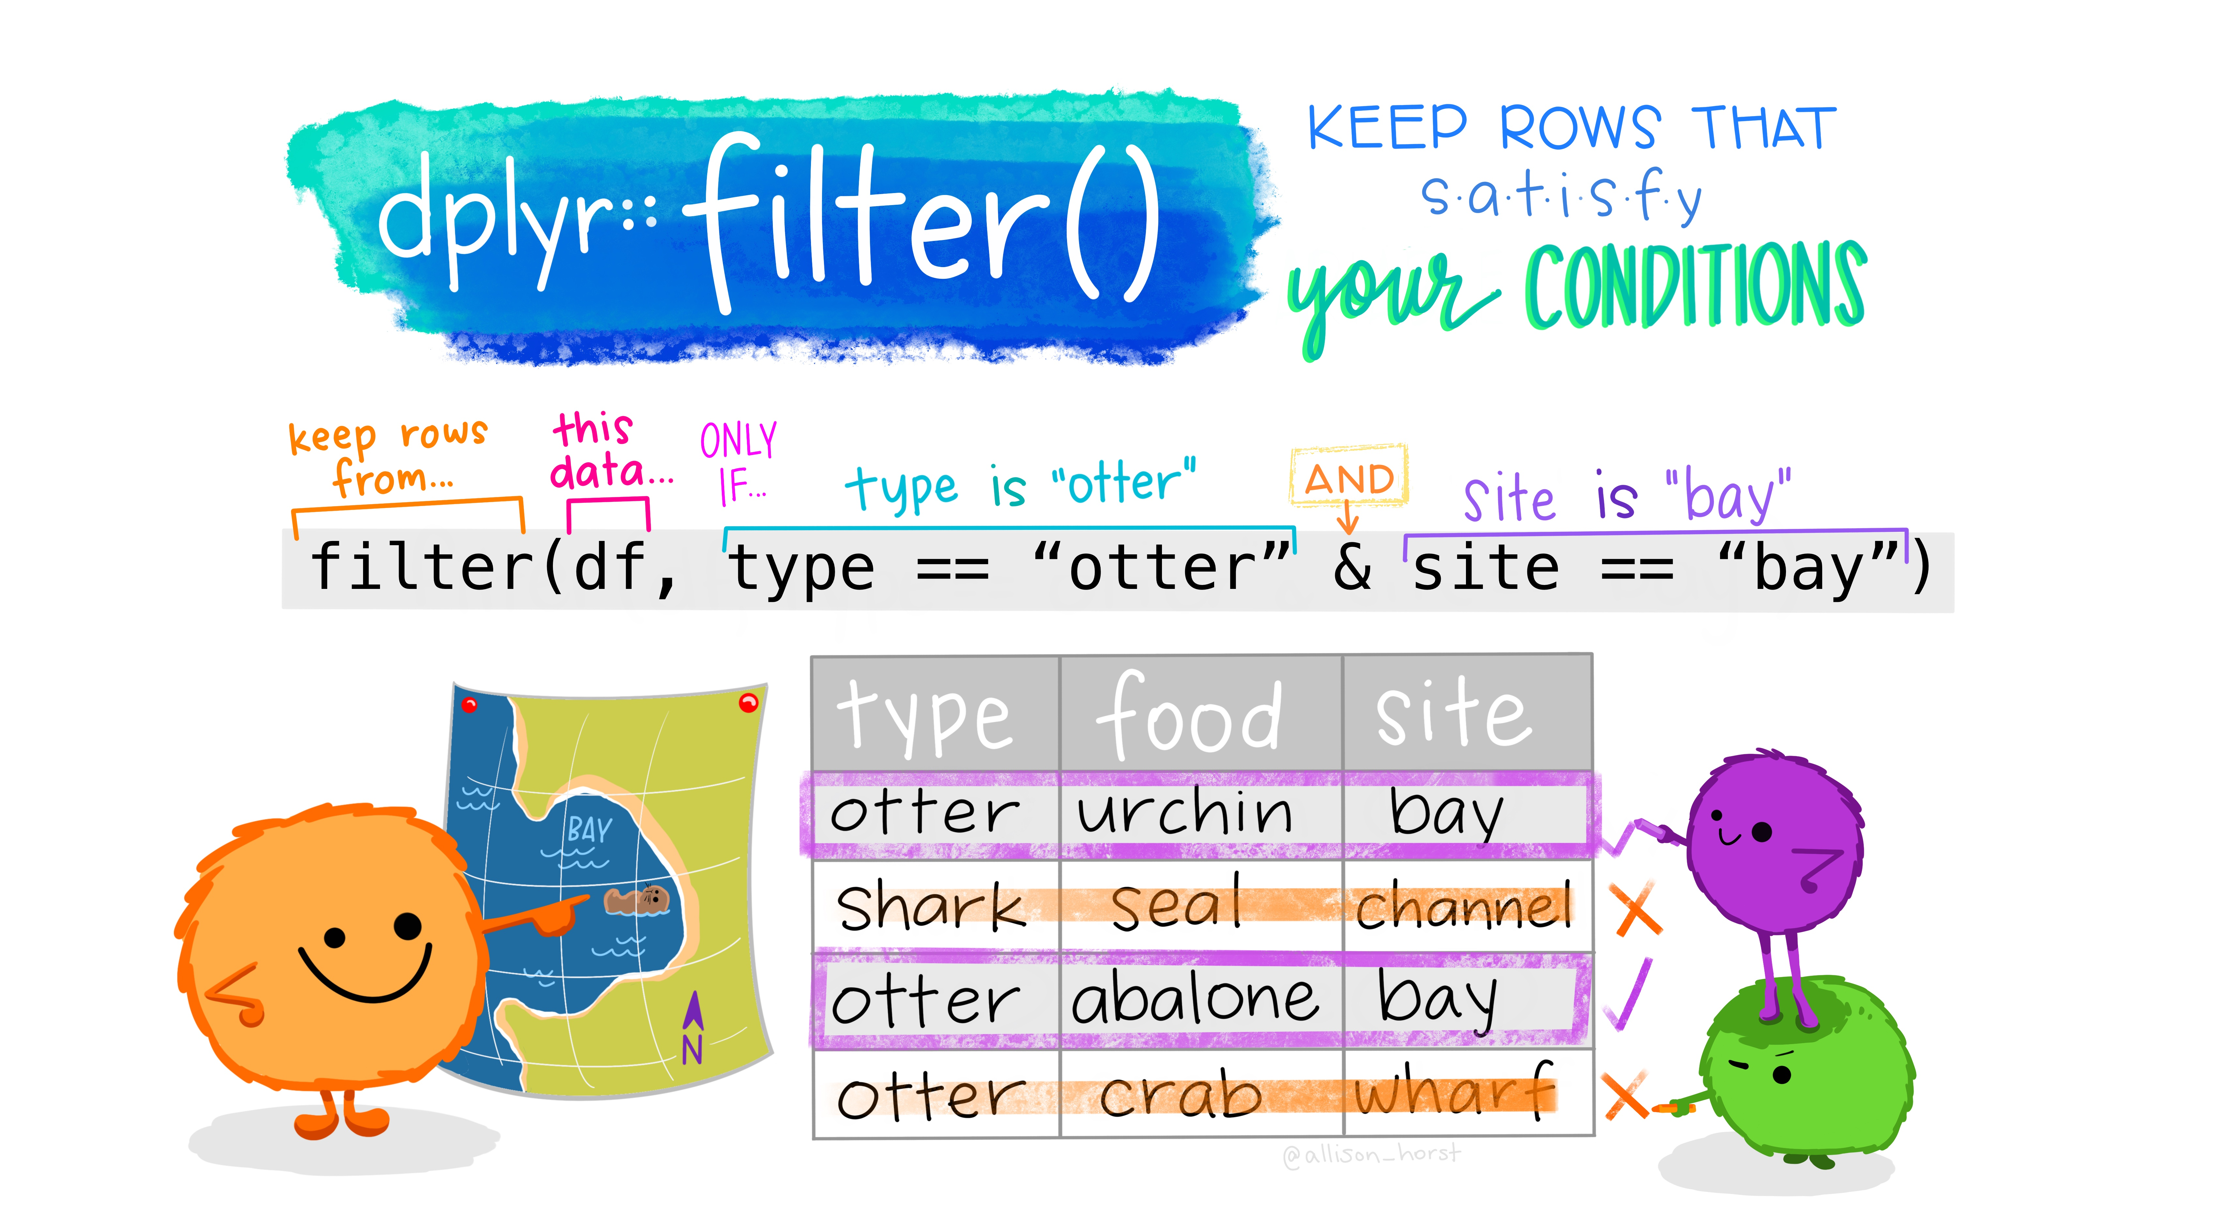
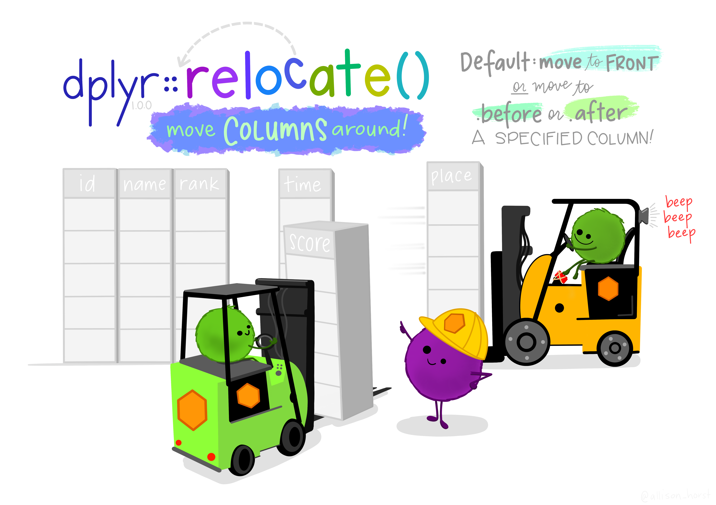
Data transformation using dplyr
Dplyr::a grammar of data manipulation
Image: allisonhorst
Notes:
dplyr is a grammar of data manipulation, providing a consistent set of verbs that help you solve the most common data manipulation challenges[1]. As such, dplyr enables you to transform the data into the right form that you need, to permit further analysis or visualization.

Slide 11
Examine real world data

Slide 12
Examine real world data
Data presented in educational material is often remarkably perfect Real world data can contain many different issues that can affect the utility of the data, and our interpretation of the results.
Check for missing values and badly recorded data
Consider removal of obvious outliers
Consider what real-world factors might affect your analysis and consider if your dataset size is large enough to handle this
Check for biased raw data and consider your options to fix this, if found
Notes:
Real world data can contain many different issues that can affect the utility of the data, and our interpretation of the results.
It's important to realize that most real-world data are influenced by factors that weren't recorded at the time. For example, we might have a table of race-car track times alongside engine sizes, but various other factors that weren't written down - such as the weather - probably also played a role. If problematic, the influence of these factors can often be reduced by increasing the size of the dataset.
In other situations, data points that are clearly outside of what is expected - also known as 'outliers' - can sometimes be safely removed from analyses, though care must be taken to not remove data points that provide real insights.
Another common issue in real-world data is bias. Bias refers to a tendency to select certain types of values more frequently than others, in a way that misrepresents the underlying population, or 'real world'. Bias can sometimes be identified by exploring data while keeping in mind basic knowledge about where the data came from.
Remember, real-world data will always have issues, but this is often a surmountable problem. Remember to:
Check for missing values and badly recorded data
Consider removal of obvious outliers
Consider what real-world factors might affect your analysis and consider if your dataset size is large enough to handle this
Check for biased raw data and consider your options to fix this, if found

Slide 13

Challenge: Analyze flight data
Let's say the Department of Transportation is considering the addition of a new airport. You have been requested to explore existing data.
In this challenge, you'll explore a real-world dataset containing flights data from the US Department of Transportation.
Notes:
Data presented in educational material is often remarkably perfect, designed to show students how to find clear relationships between variables. 'Real world' data is a bit less simple.
Because of the complexity of 'real world' data, raw data has to be inspected for issues before being used.
As such, best practice is to inspect the raw data and process it before use, which reduces errors or issues, typically by removing erroneous data points or modifying the data into a more useful form.

Slide 14
Prerequisites
Before taking the challenge, ensure you have your machine ready to start
Or
Open the notebook into the cloud
Docker
Install and configure Docker for your operating system
VS Code
Install VS Code and the Remote Development extension pack
Add Configuration Files
Press F1 select and Add Development Container Configuration Files... command for Remote-Containers or Codespaces.
Select the definition
Select this definition. You may also need to select Show All Definitions... for it to appear.
Open folder in container
Finally, press F1 and run Remote-Containers: Reopen Folder in Container to start using the definition.
Launch Binder

Slide 15
Knowledge check

Slide 16
Question 1
You have a tibble/data frame with the dimension [20, 2]. What does this tell you about the tibble?
The tibble consists of 20 rows and 2 columns.
The tibble contains 2 columns, with the values 2 and 20.
The tibble contains 20 rows, all with the value 2.
Notes:
Explanation: That is correct. A data frame with the dimension 20, 2 means that it has 2 columns each with 20 elements. This gives the data frame a rectangular structure of 20 rows and 2 columns.

Slide 17
Question 1
You have a tibble/data frame with the dimension [20, 2]. What does this tell you about the tibble?
The tibble consists of 20 rows and 2 columns.
The tibble contains 2 columns, with the values 2 and 20.
The tibble contains 20 rows, all with the value 2.
Notes:
Explanation: That is correct. A data frame with the dimension 20, 2 means that it has 2 columns each with 20 elements. This gives the data frame a rectangular structure of 20 rows and 2 columns.

Slide 18
Question 2
You have a data frame named df_sales containing daily sales data. The data frame contains the following columns - year, month, day_of_month, sales_total. You want to find the average sales_total value. Which code should you use?
df_sales %>% pull(sales_total) %>% avg()
mean(sales_total$df_sales)
mean(df_sales$sales_total)
Notes:
Explanation: That is correct. The accessor (`$`) extracts the elements in the sales_total column of df_sales data frame. These are then passed on to the mean() function that computes the average.

Slide 19
Question 2
You have a data frame named df_sales containing daily sales data. The data frame contains the following columns - year, month, day_of_month, sales_total. You want to find the average sales_total value. Which code should you use?
df_sales %>% pull(sales_total) %>% avg()
mean(sales_total$df_sales)
mean(df_sales$sales_total)
Notes:
Explanation: That is correct. The accessor (`$`) extracts the elements in the sales_total column of df_sales data frame. These are then passed on to the mean() function that computes the average.

Slide 20
Question 3
You have a data frame containing data about daily ice cream sales. You use the R function cor to compare the avg_temp and units_sold columns, and get a result of 0.97. What does this result indicate?
On the day with the maximum units_sold value, the avg_temp value was 0.97.
Days with high avg_temp values tend to coincide with days that have high units_sold values.
The units_sold value is, on average, 97% of the avg_temp value.
Notes:
Explanation: That is correct. The corr method returns the correlation, and a value near 1 indicates a positive correlation.

Slide 21
Question 3
You have a data frame containing data about daily ice cream sales. You use the R function cor to compare the avg_temp and units_sold columns, and get a result of 0.97. What does this result indicate?
On the day with the maximum units_sold value, the avg_temp value was 0.97.
Days with high avg_temp values tend to coincide with days that have high units_sold values.
The units_sold value is, on average, 97% of the avg_temp value.
Notes:
Explanation: That is correct. The corr method returns the correlation, and a value near 1 indicates a positive correlation.

Slide 22
Summary

Slide 23
Summary
Common data exploration and analysis tasks
How to use R packages like ggplot2 and dplyr to turn raw data into understanding, insight and knowledge
Examine real world data

